Slide 1

Object Oriented Programming-I
CS-322
Lecture No 1
Introduction to Programming in C++
June 2020
Instructor: Bilal Jan

Slide 2

Outlines
What is a program?
C++ and other languages
The cocktail of different ingredients from coding to executing a program
Dressing-up the platform for this course
Lets dirty our hands with basic programming constructs
Brushing up for tomorrow

Slide 3



Program
The set of instructions that tells a machine to perform a specific task.
The set of instructions written in a proper format as provided by the Programming Language is called as Source Code
A computer program takes some input, processes it and gives desired final output.
Analogous to your favorite recipe where all the required ingredients, act as input, are mixed in proper order, processing, for your delicious final dish, as output.

Slide 4






Problem, Algorithm and Program
An algorithm is a systematic approach that deals with set of rules fabricated in a very formal way for solving a particular problem in hand. The idea or concept may be in different forms, thus several possible algorithms, for the same problem leading to possible solution(s) each one with its own complexity and effectiveness.
A computer program is the implementation of such algorithm (design, concept, idea) in some high level computer language for solving a particular problem.
Problem
Algorithm
Program
Solution
Not me but You

Slide 5
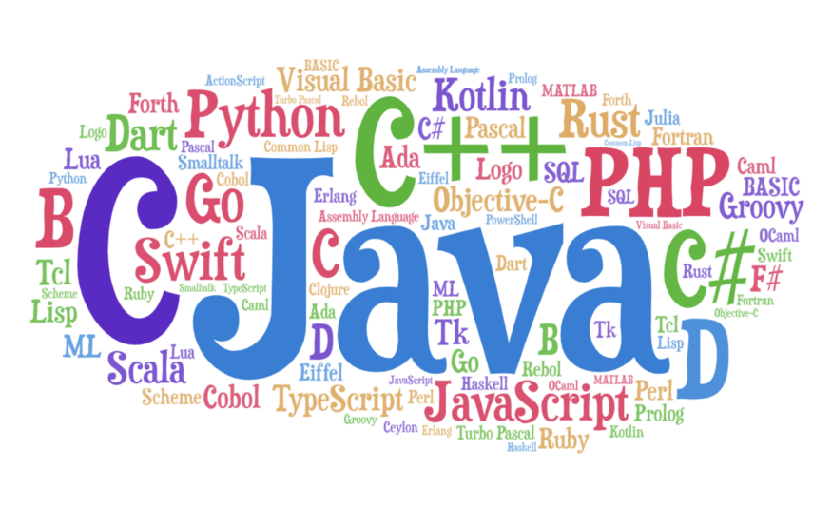

Computer Languages
Computer language is the medium used by a programmer to communicate with computer inorder to understand, process and execute instructions for a required task
Low Level:- Easily understood by computer, direct interaction with hardware but hard to code
Machine Language, Assembly Language
High Level:- Easily coded since mostly English oriented with different flavors of coding styles, require translation software for computer to understand and process the code
Fortran, Python, Java, C, C++, C#, etc
Some brief explanation and extensive work
https://medium.com/javarevisited/70-years-of-hello-world-with-50-programming-languages-2400de893a97

Slide 6
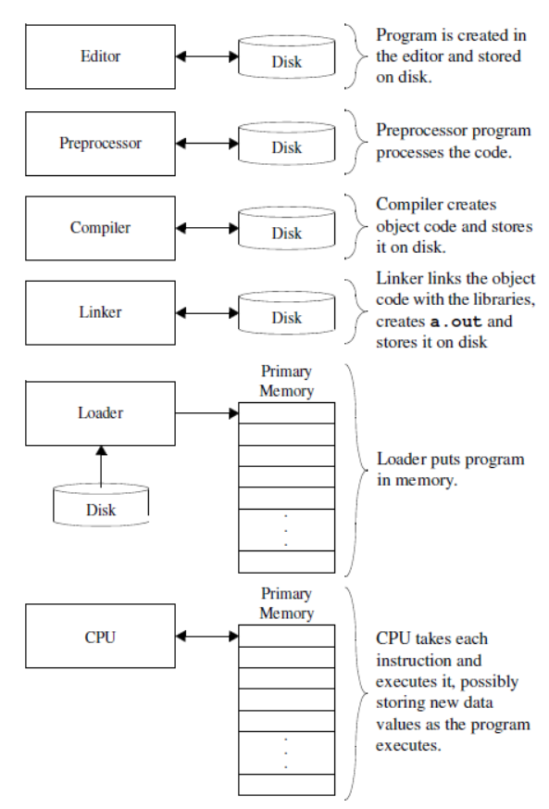
Basic Building Blocks
Editor
The main area where programmer writes the source code. Typically an IDE provides the front end for write code, debugging interface and related environment for different settings
Preprocessor
Resolving/including any preprocessor directives into the source code before execution (#include, #define etc)
Compiler
The main software component taking the source code, debugging for different errors, converting to intermediate representation and cooking the source code for target execution at back end in form of object files. (the IDE typically provides the compiler in its tool kit such as Eclipse. also installable as separate component eg. g++ etc)
Deitel, Paul J., and Harvey M. Deitel. C++ how to program. PearsonPrentice Hall, 2008.

Slide 7
Basic Building Blocks…
Linker
The linker often works in a three-fold fashion. Firstly it links all the different libraries included in the source code. Secondly all the generated object files are grouped and lastly the linked libraries with grouped object files are combined in a single executable (.exe) file.
Loader
Loader component of the Operating System actually loads the executables inside computer main memory (RAM) and prepares for program execution.
Execution
Once the loader completes its job of placing every thing in RAM the OS gives charge to loaded program for execution where instructions are executed in the order of the source program.
Deitel, Paul J., and Harvey M. Deitel. C++ how to program. PearsonPrentice Hall, 2008.

Slide 8

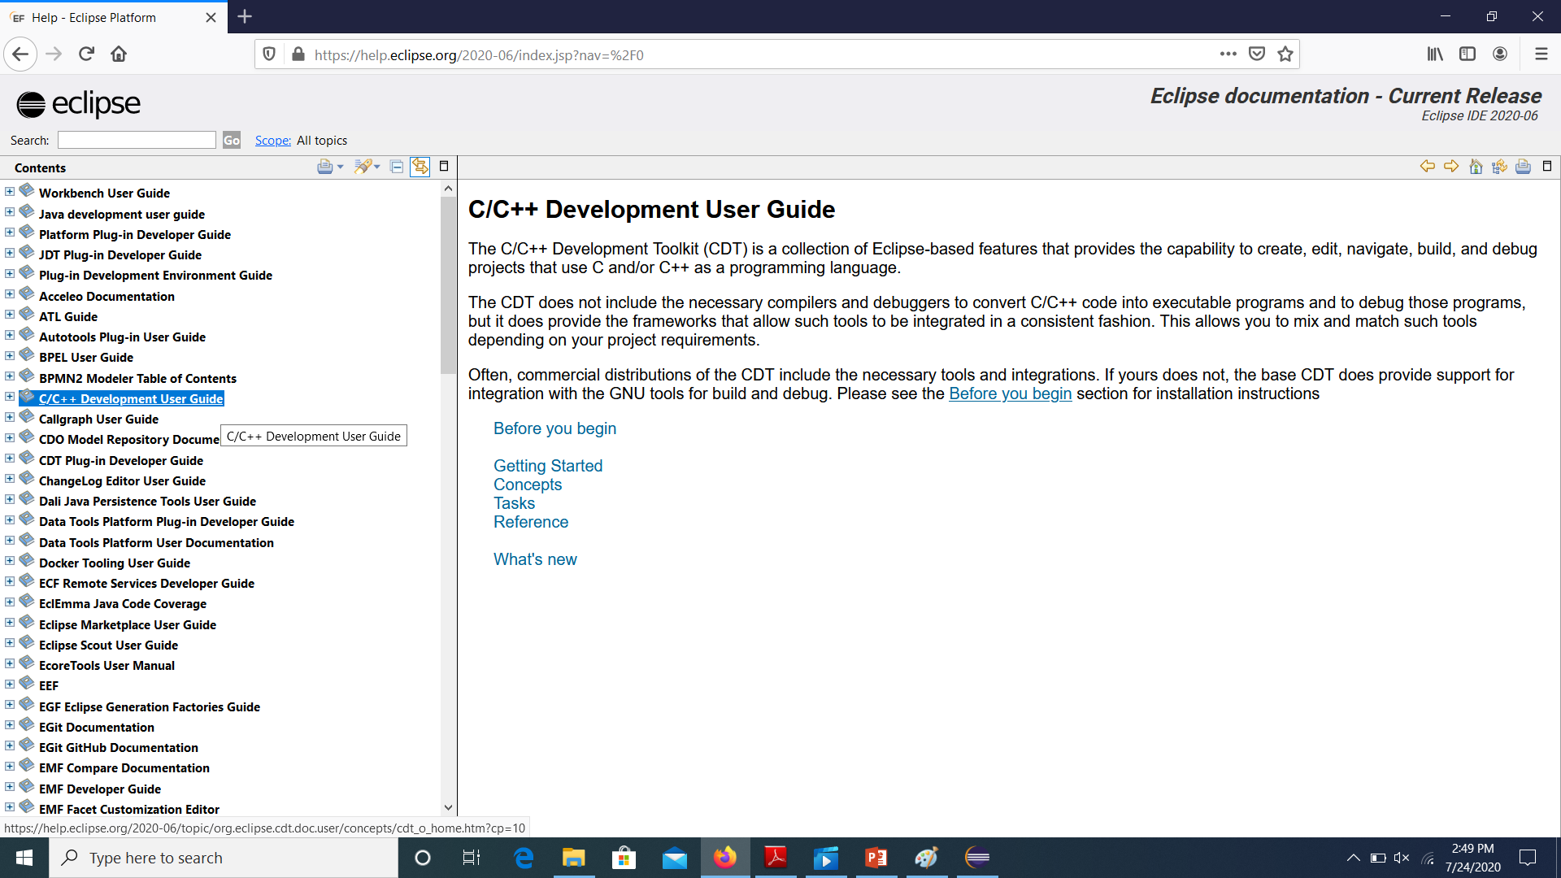
Platform for this course
Eclipse IDE as target environment for writing source code
You need to download the required CDT and read related documentation at https://help.eclipse.org/2020-06/index.jsp?nav=%2F0

Slide 9
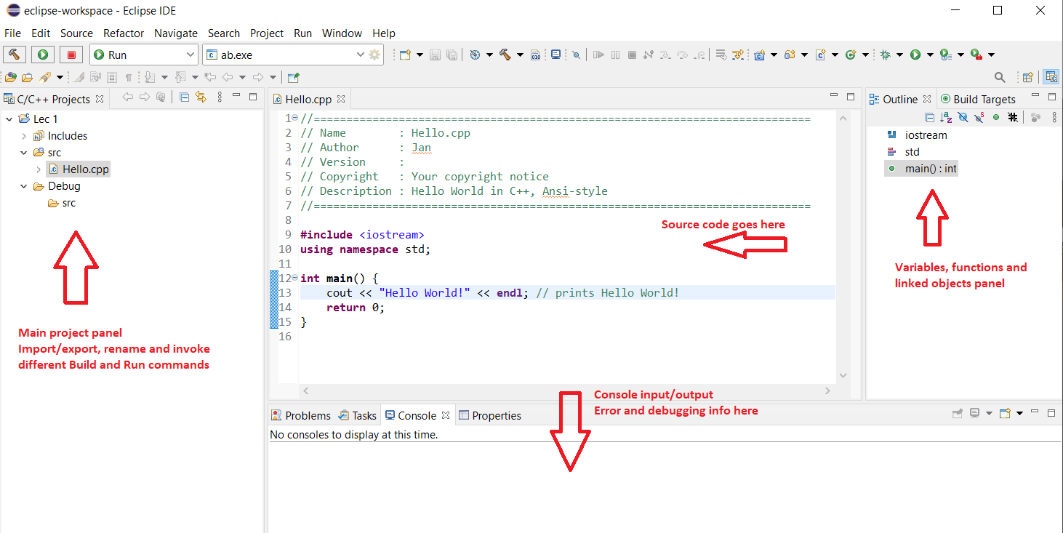
The Eclipse IDE

Slide 10
Installing the Eclipse CDT
Eclipse CDT Package
The required MinGW environment for g++
Setting the path i.e. telling eclipse where to locate the compiler for source code

Slide 11
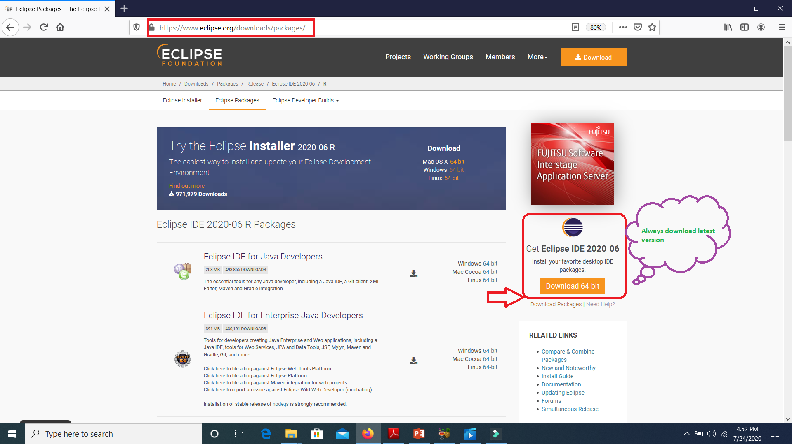
1. Eclipse CDT Package

Slide 12
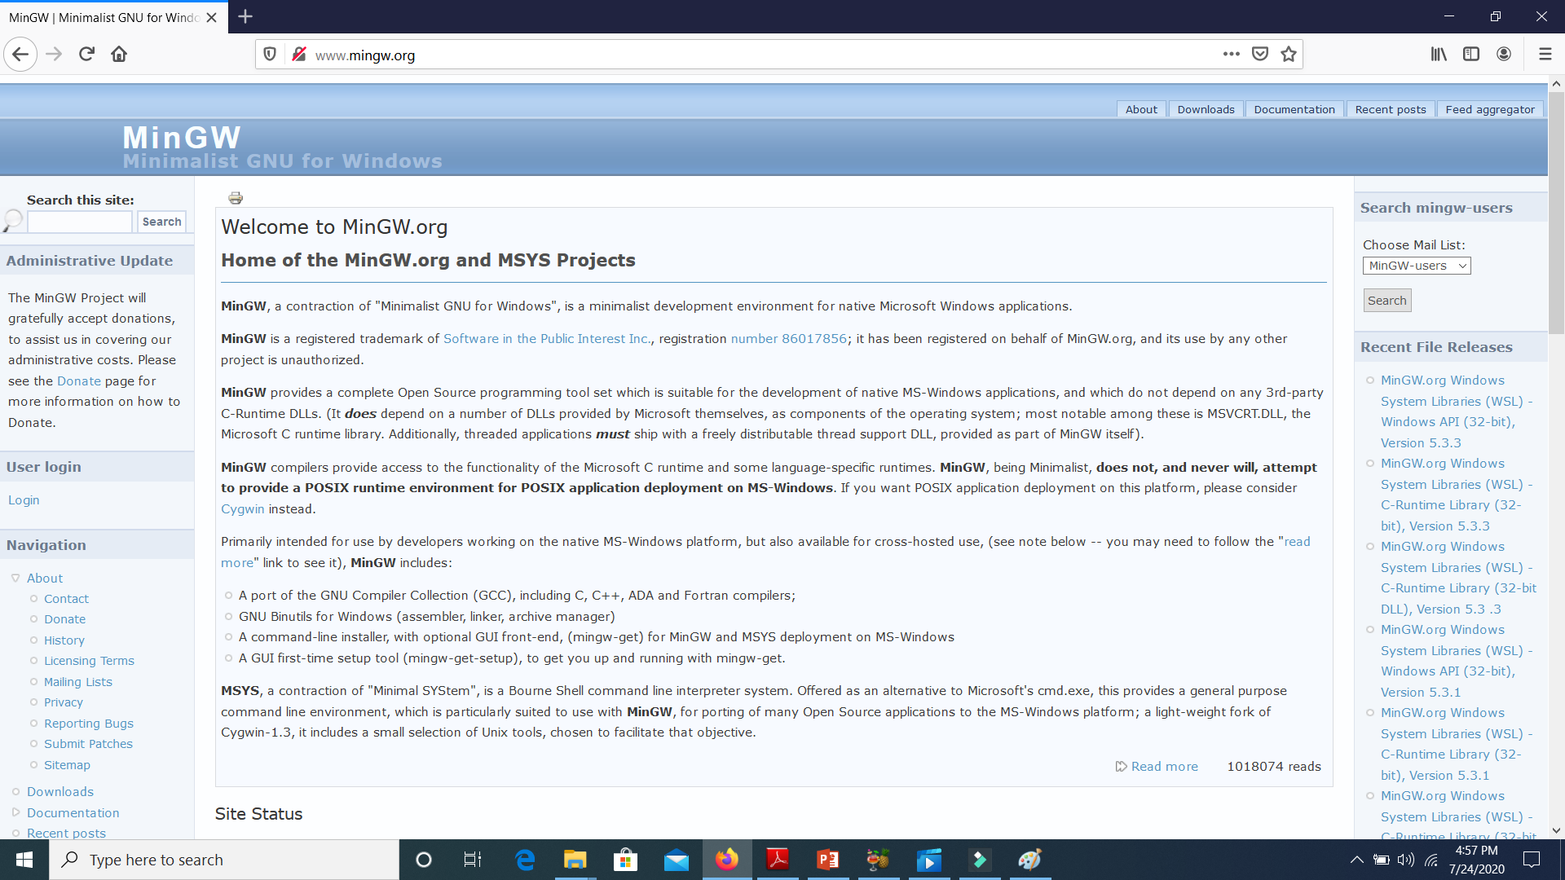
2. MinGW

Slide 13
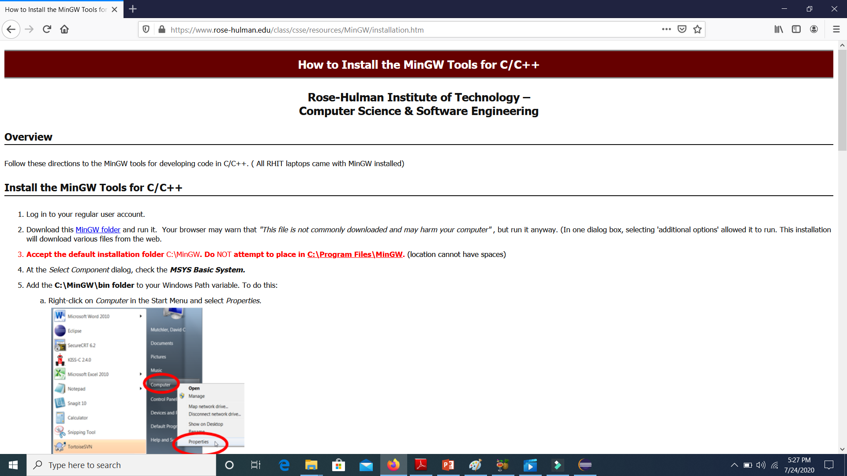
2. MinGW installation site

Slide 14
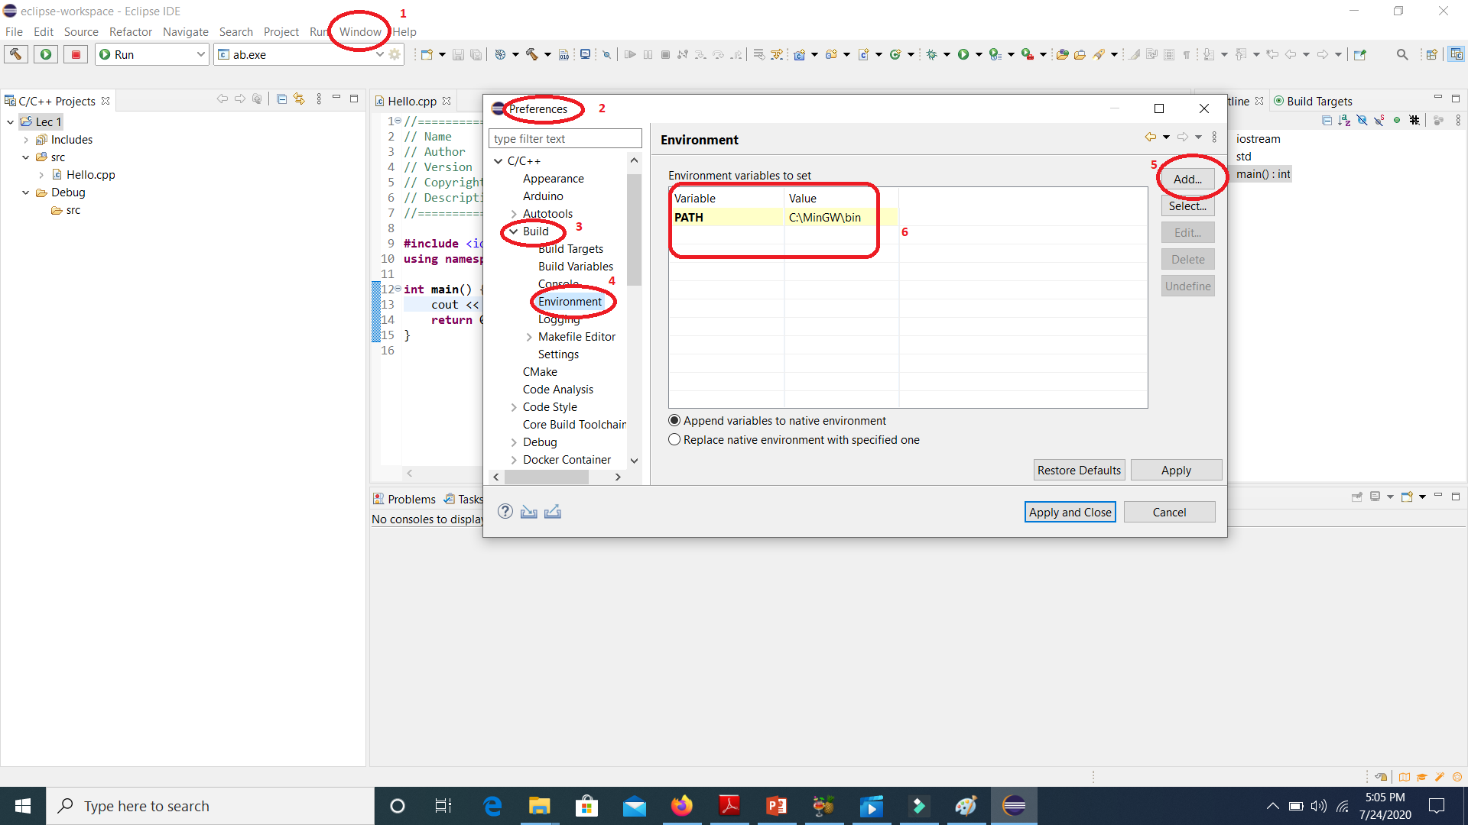
3. Setting the path
Copy the complete path to MinGW\bin location and follow steps 1-6

Slide 15
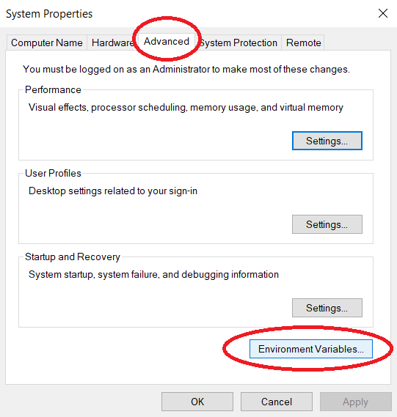
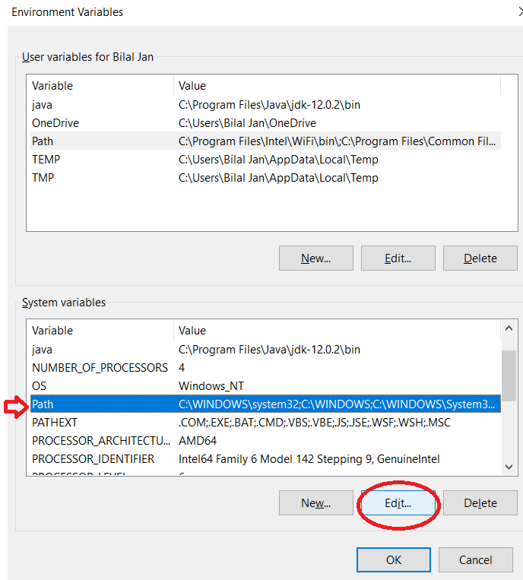
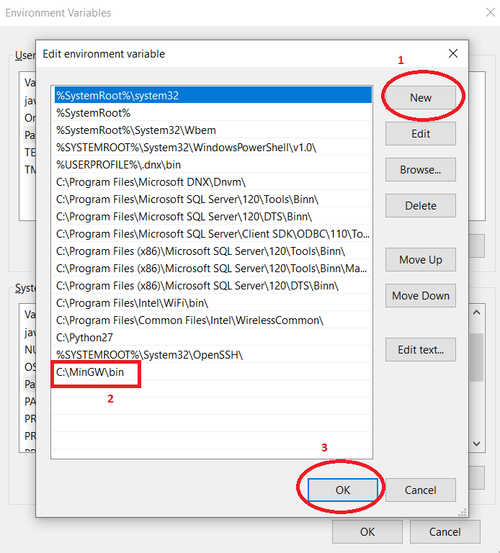
3. Setting System Environment Variables
Go to Edit System Environment Variables

Slide 16
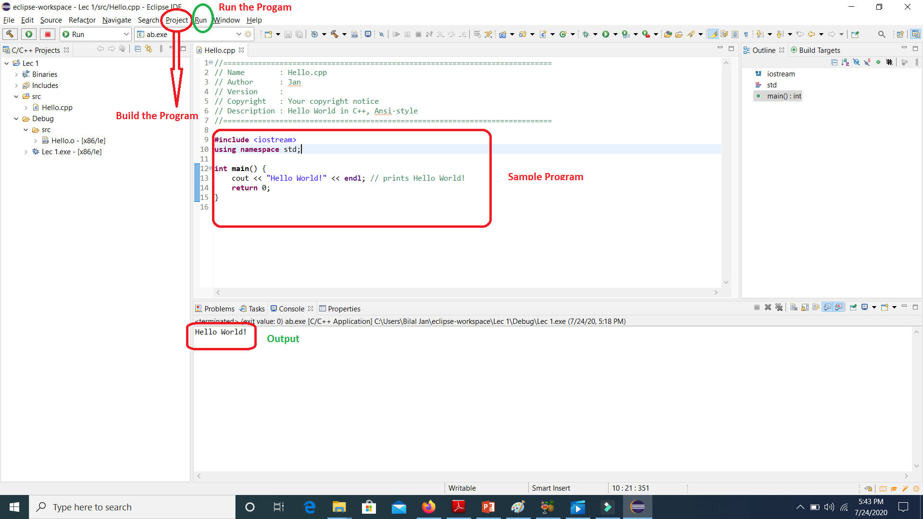
First Program The Hello World!

Slide 17
Coming Up NEXT
Control Structures in C++

Slide 18
Special thanks to
https://www.flaticon.com/
https://www.rose-hulman.edu/class/csse/resources/MinGW/installation.htm
https://www.eclipse.org/downloads/packages/release/kepler/sr2/eclipse-ide-cc-developers
http://www.mingw.org/

